Slide 1
Influences of mobile gaming ratings, what are they?
Matthew Cornelius
Bellevue University
02/21/2020
DSC 530

Slide 2
Introduction
The chosen dataset has over 15,000 entries concerning the components of mobile gaming applications.
Aspects of the dataset cover a range of different attributes to gaming the applications from your typical app store.
Ex: name, descriptions, ratings, genre, etc.
The underlying point of research the dataset:
Attempting to determine what components of an application are the most important.

Slide 3

The Big Question
What are, or if any components of a mobile game application, can influence the average user rating?

Slide 4
The Chosen Few(Variables)
Price: The monetary cost in U.S. currency to the user that wishes to download/install the selected application.
Average user rating: This is an averaged number from the cumulative review scores that the users having given a specific app. The rating is on the scale of 0 – 5.
User rating count: The raw amount or total reviews that the selected application has received from it’s user base.
Age rating: The intended age of a person or demographic that the developers designed the application for.
Size: The overall file size of the application in megabytes.

Slide 5

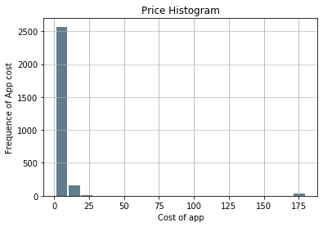
Price – In U.S. Dollar
Mean: 4.9
Mode: 0.99
Median : 1.99
Max: 179.99
Min: 0.99
No outliers, maximum and minimum values occur many times within data.
The histogram is a depiction of the cost of all the apps from the data set, and the frequency at which they appear.
As indicated by the graph the vast majority of the pricing for the apps fall below $25.
However even though not visible there are values between $25 – 175.

Slide 6
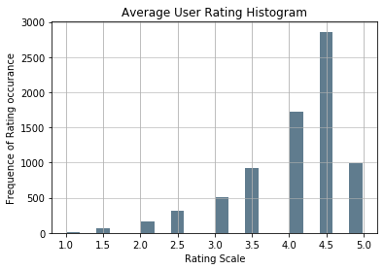
Average User Rating – Scale: 0 - 5
Mean: 4.1
Mode: 4.5
Median: 4.5
Max: 5.0
Min: 1.0
No outliers
Every app has an averaged rating on the scale of 0 -5.
The graph shows the frequency at which the review scores appear.
The most frequent score seems to be 4.5 out of 5 on the rating scale.

Slide 7
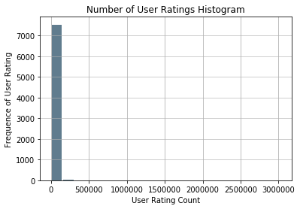
User Rating Count
Mean: 3306.5
Mode: 5.0
Median: 46.0
Max: 3032734.0
Min: 5.0
No outliers, count is just heavily weighted toward one side.
Although not visible the count of user rating declines in a linear fashion from a maximum of ~3 million.
The overwhelming vast majority of the number of times the users reviewed an application fall 250,000.
Applications that did not have the count recorded where excluded.

Slide 8
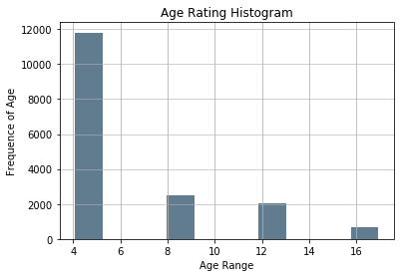
Age Rating
Mean: 6.20
Mode: 4.0
Median: 4.0
Max: 17.0
Min: 4.0
No outliers
The age range for all apps in data was between 4 -17+.
A large portion of the apps were developed for a younger audience.

Slide 9
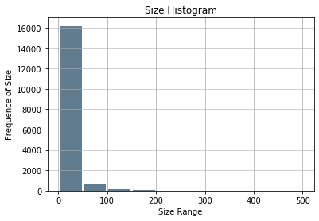
Size – In Megabytes
Mean: 14.5
Mode is: 6.1
Median: 7.1
Max is 500.7
Min: 0.01
No outliers, amounts gradually lower from maximum values.
The majority of file size for the applications fall below 50 megabytes.
From maximum file size the app size declines in linear fashion, even if not depicted.

Slide 10
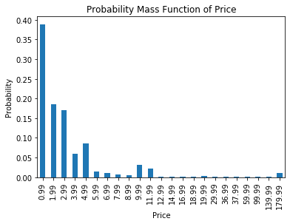
PMF of Price
Price against itself, or in other words the probability an application will have that price.
Around 40% of the applications seem to be either free or below $0.99.
The probability of appearance seems to decline in a somewhat linear fashion until $11.99.
After $11.99 the probability of an app having that price is relatively consistent.

Slide 11
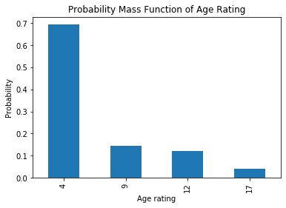
PMF of Age Rating
The probability an application will have a specific age rating.
As indicated by the age rating histogram, most of the apps have an age rating of 4.
Decline of the probability as the age rating rises.
Could be an indication that most apps are made for a younger audience.

Slide 12
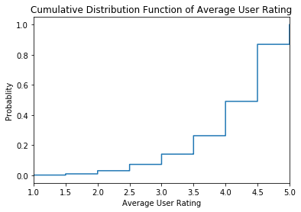
CDF of Average User Rating
The probability of the average user rating that an application under.
Applications that have a low rating seem to also appear at a low rate.
100% of all ratings fall under the 5/5 score.

Slide 13
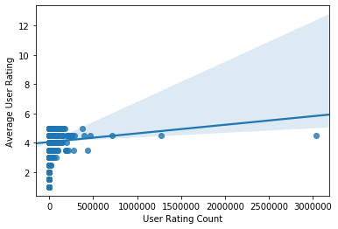
Regression Model
A regression model of the user rating count versus the average user rating.
The majority of the user rating count is under 500,000.
Very small positive regression line
Likely almost non existent relationship between the user rating count and rating of the application.

Slide 14
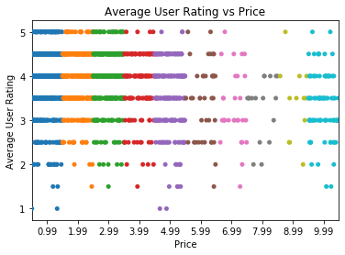
Average User Rating vs Price Scatter
Scatter plot of the prices of applications below $10.
Gives a visual of how the distribution of user rating scores correlated to a price point below $10.
Prices above $10 were excluded, due to the majority of application prices falling under $10.

Slide 15
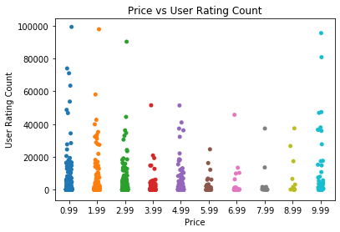
Price vs User Rating Count Scatter
Graphical depiction of the relationship of apps with prices below $10, and the user rating count under 100,000.
Shows how often an app at a price under a specific user rating count appears.
As indicated before most of the prices fall at or below $0.99.

Slide 16
Conclusions
Most applications are made for a younger demographic.
The lower the price the more often it corelates to a the younger age rating of an application.
User rating count does not seem to have a strong effect on the average user rating.
Cheaper applications get more user rating counts.
Largest influence on average user rating seems to be age rating

